Slide 1

New Forms of Data and the Analysis of Cities
Patrick Ballantyne, University of Liverpool
P.Ballantyne@liverpool.ac.uk

Slide 2

About Me
Postdoctoral Research Fellow:
Geographic Data Science Lab, University of Liverpool
Research Interests:
Retail, COVID-19, Geodemographics,
Consumer, Location and Mobility Data
New Forms of Data and the Analysis of Cities

Slide 3
Overview
New Forms of Data and the Analysis of Cities

Slide 4
Overview
Cities; form and function
New forms of data = insights
Case study; retail centres
New Forms of Data and the Analysis of Cities

Slide 5

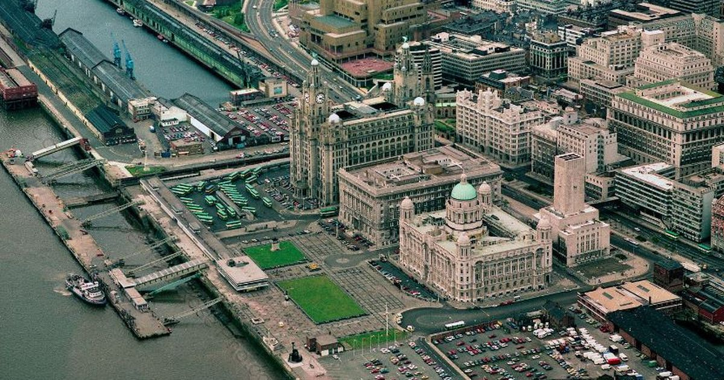
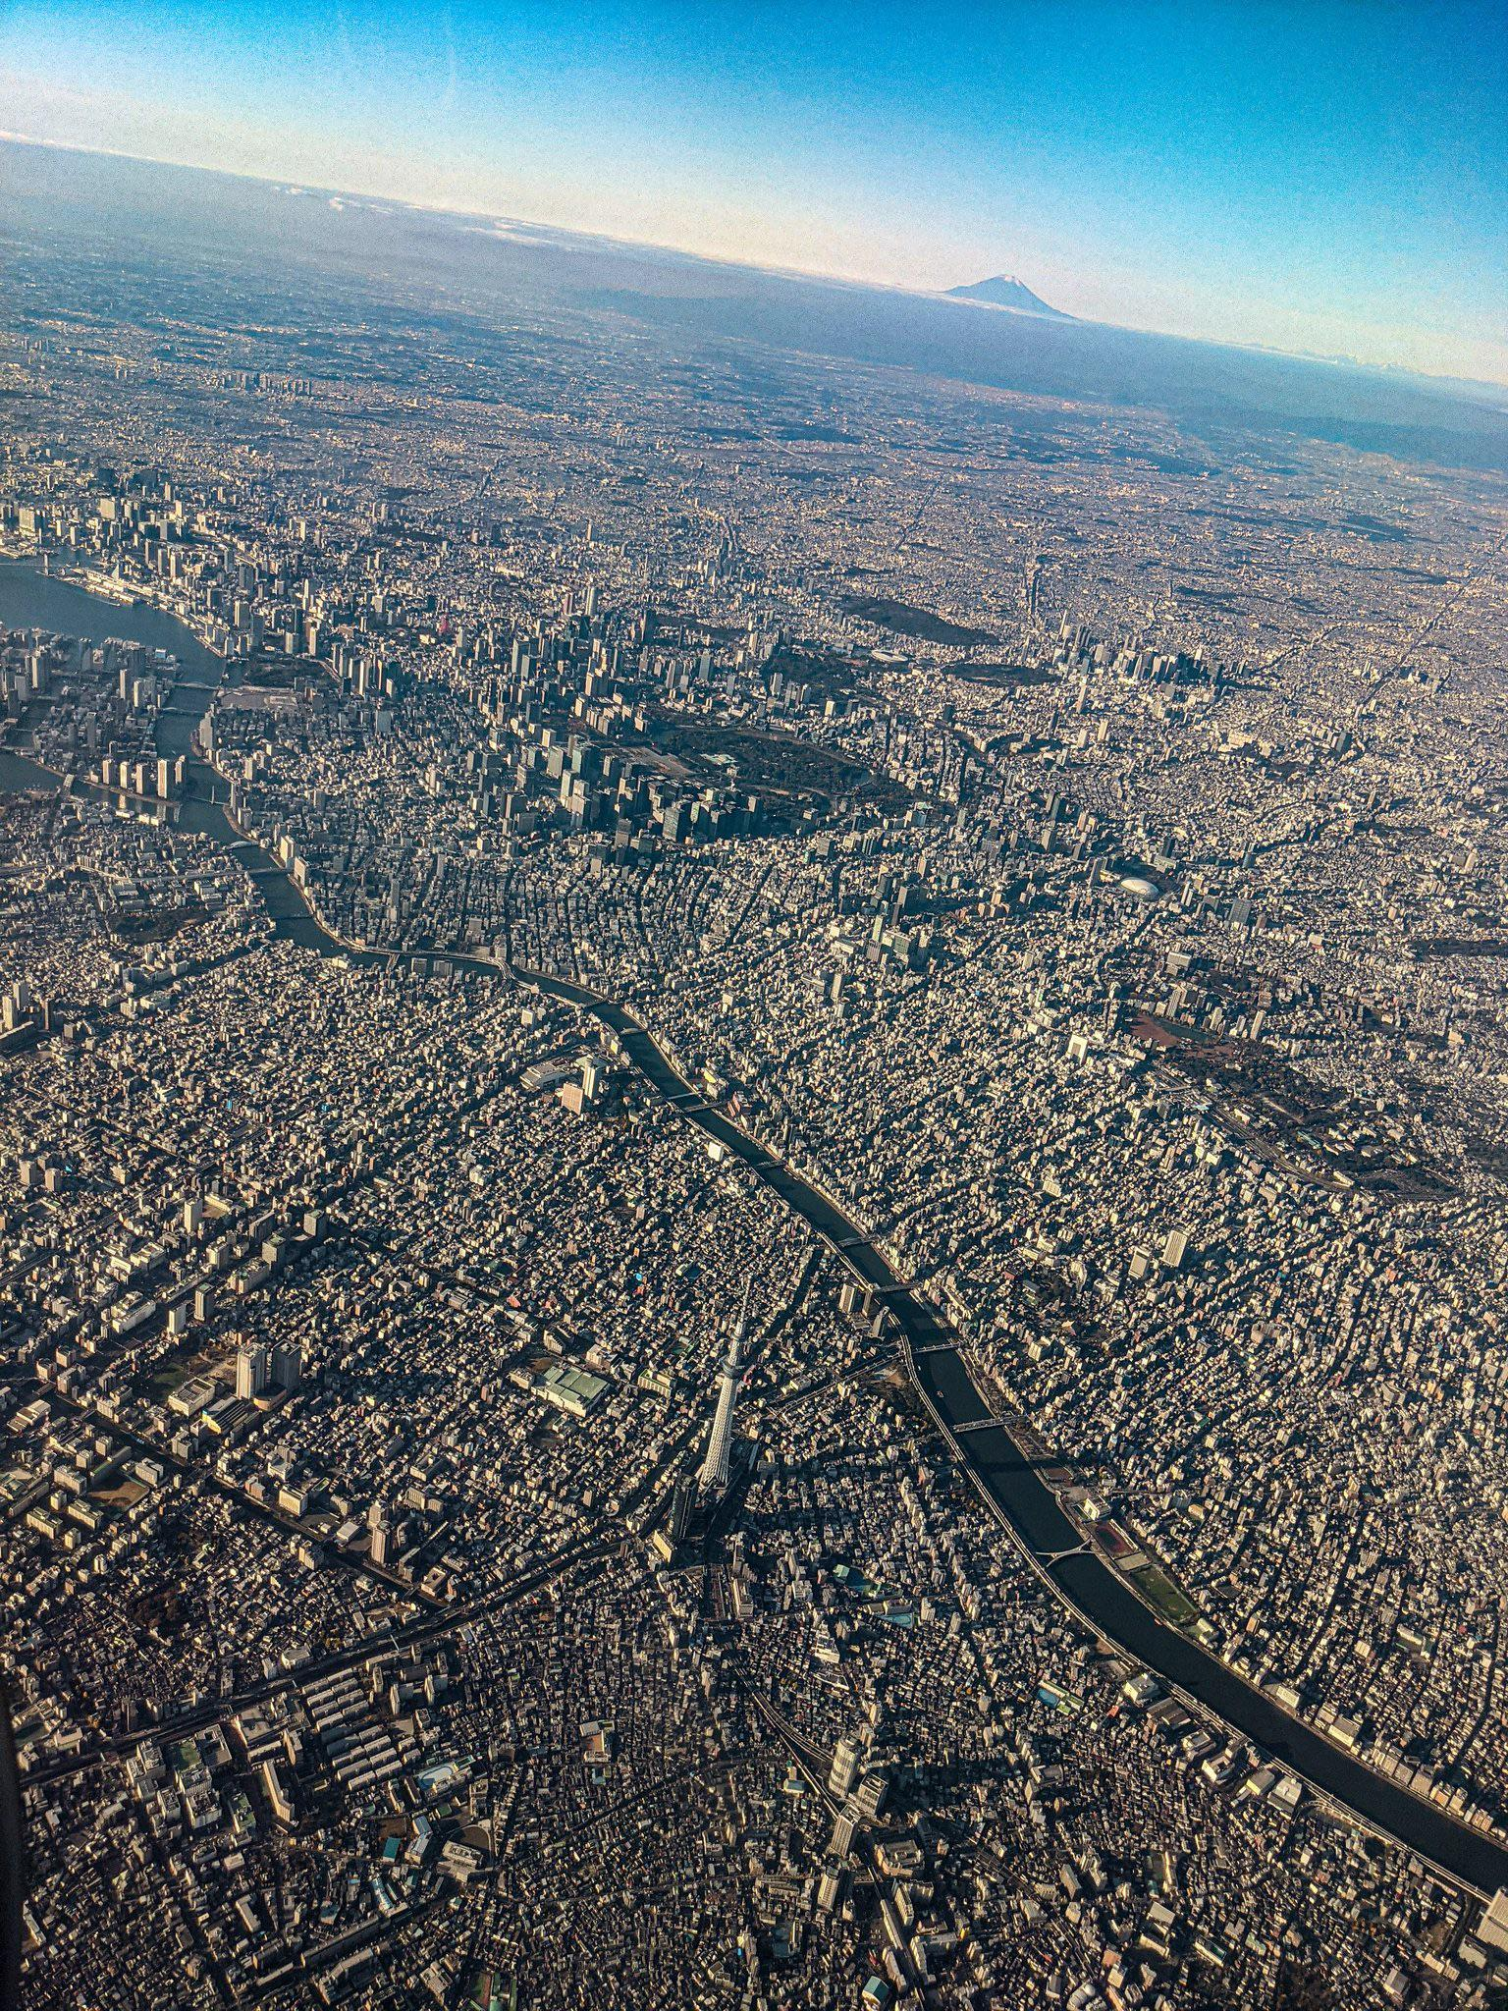
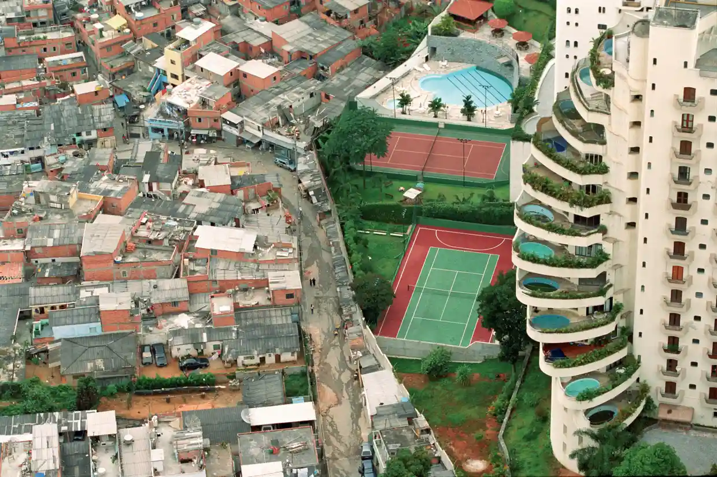
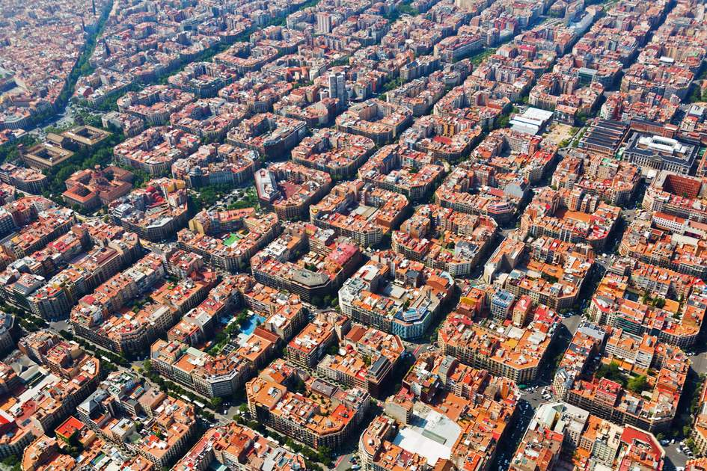
Cities
Tokyo, Japan
London, UK
Liverpool, UK
Sao Paulo, Brazil
New Forms of Data and the Analysis of Cities
Barcelona, Spain

Slide 6
Cities
Urban Form and Function
New Forms of Data and the Analysis of Cities
Notes:
This is my chosen way to talk to you about cities; based on my own interests…
But you can think of lots of different ways of viewing cities and data used to interact with them;
People who live there
Availability of green space/provision of mental health/wellbeing

Slide 7
Cities
Urban Form and Function
“The visible shape or configuration of something ...”
New Forms of Data and the Analysis of Cities

Slide 8
Cities
“The reason for which something exists...”
Urban Form and Function
“The visible shape or configuration of something ...”
New Forms of Data and the Analysis of Cities

Slide 9
Cities
Tokyo, Japan
London, UK
Liverpool, UK
Sao Paulo, Brazil
New Forms of Data and the Analysis of Cities
Barcelona, Spain
Notes:
Form:
TOKYO: Very densely packed, high-rise city
BARCELONA: Very distinctive morphology, grid system designed to unite poor and rich in the 1850s, gardens at the centre of each block.
SAO PAULO: Divisive urban morphology, urban favela against a luxury hotel
Function:
LONDON: Financial capital of UK
LIVERPOOL: Cultural city (stags, hen dos), port city
BARCELONA: One of the only beach cities of the world, cultural, food.

Slide 10

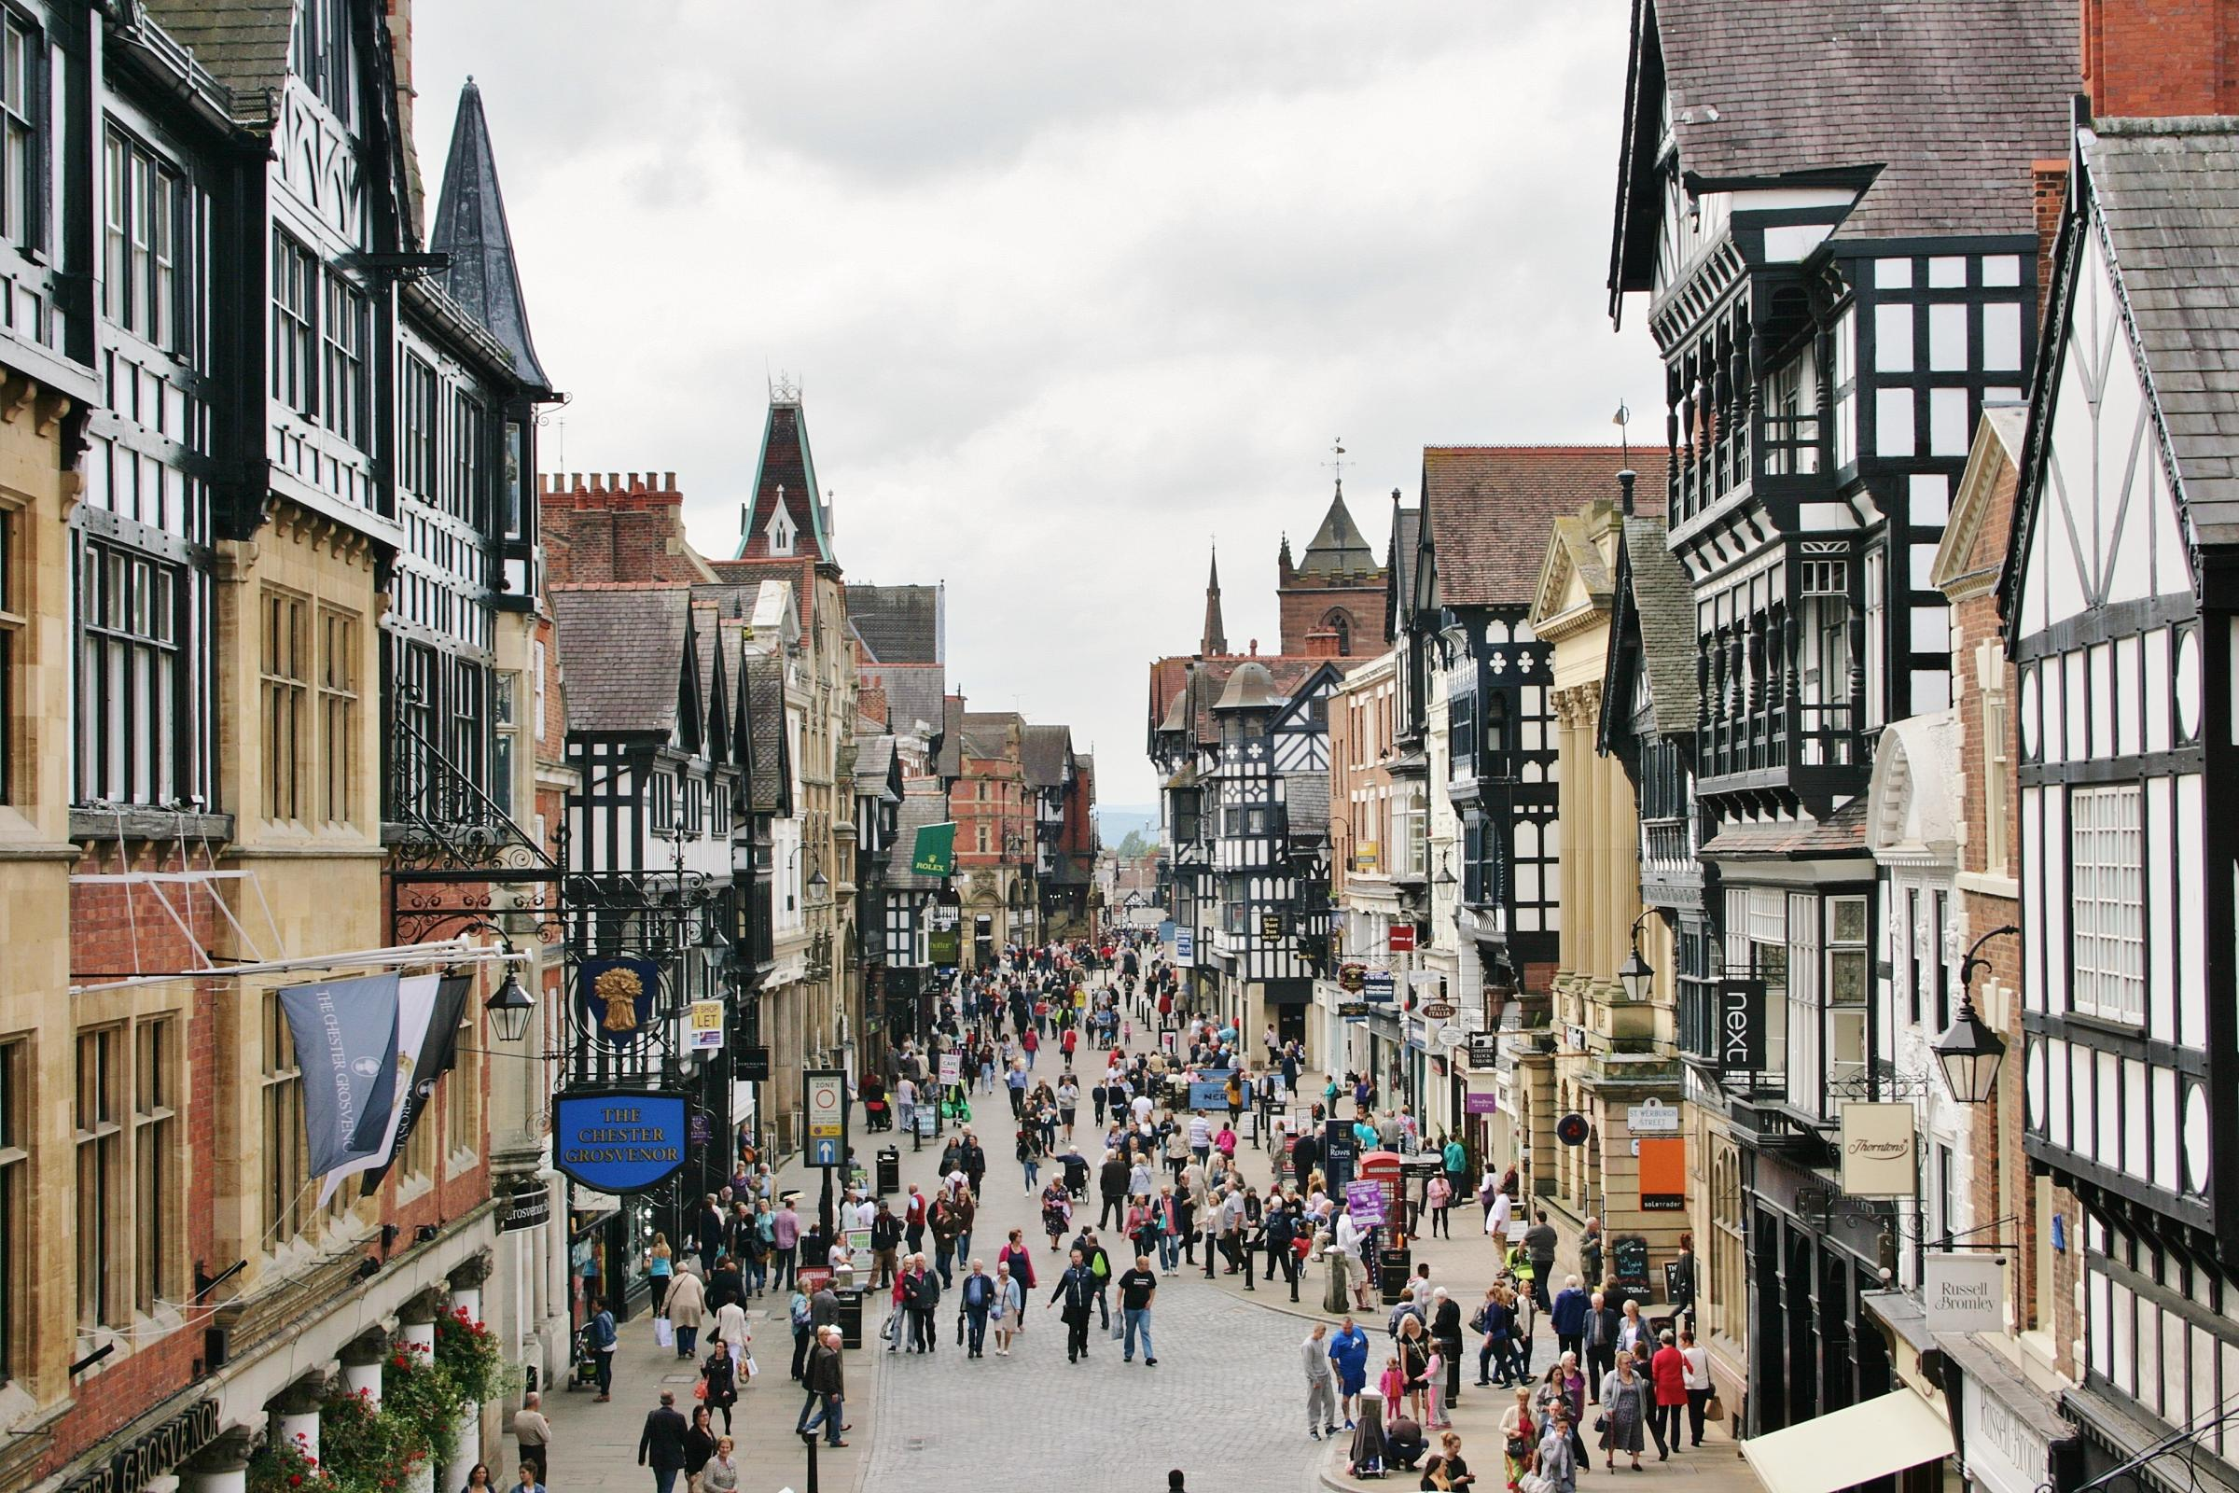
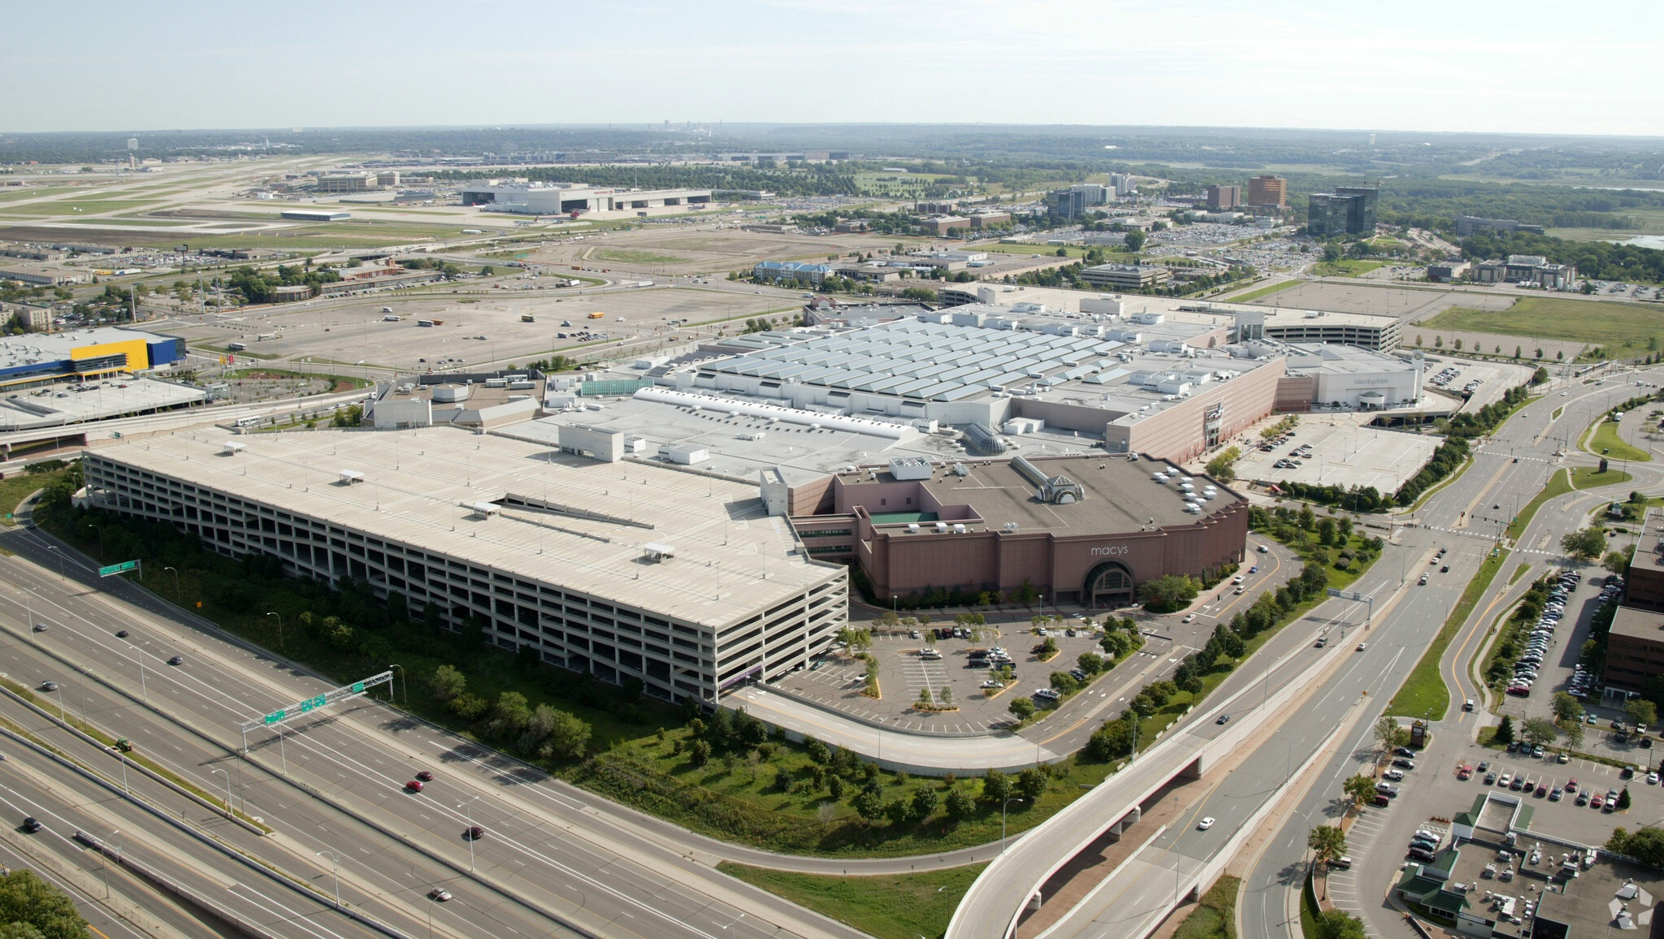

Retail
Chester, UK
Marrakesh, Morocco
Bloomington, U.S.
New Forms of Data and the Analysis of Cities
Shinjuku, Japan
Notes:
Very different forms present in retail too!
Talk about forms, how they differ (mall vs souk vs high street vs Kabukicho)
Stress functions; malls in the US typically providing a very different offering to say the Souk's in Marrakesh

Slide 11
Cities Matter!
New Forms of Data and the Analysis of Cities
Notes:
Other concepts;
They only cover about 1% of the earth’s surface; thus, they do not take up as much space as you would think.
They are responsible for 70% of global CO2 emission; climate change agenda.
Geographical phenomena, linked with all sorts of socio-economic, geo-political and environmental issues.

Slide 12
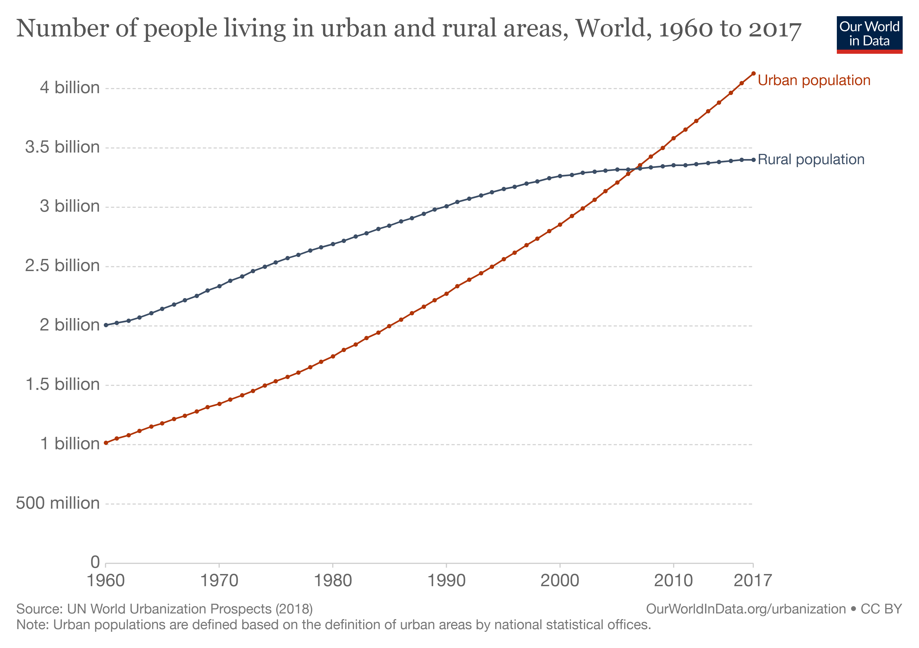
Cities Matter!
Over 50% of the world’s population live in cities...
New Forms of Data and the Analysis of Cities
Notes:
Other concepts;
They only cover about 1% of the earth’s surface; thus, they do not take up as much space as you would think.
They are responsible for 70% of global CO2 emission; climate change agenda.
Geographical phenomena, linked with all sorts of socio-economic, geo-political and environmental issues.

Slide 13

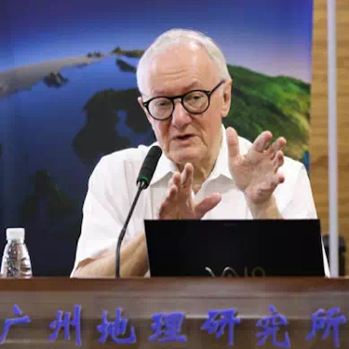
Cities Are Complex!
“Cities are largely unpredictable because they are complex systems that are more like organisms than machines. Neither the laws of economics nor the laws of mechanics apply; cities are the product of countless individual and collective decisions that do not conform to any grand plan. They are the product of our inventions; they evolve”.
New Forms of Data and the Analysis of Cities

Slide 14
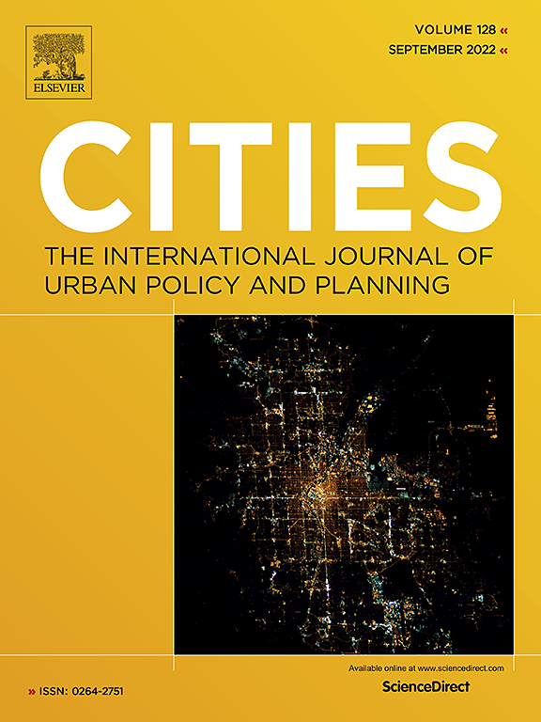



Cities Are Complex!
And many more...
New Forms of Data and the Analysis of Cities

Slide 15
Overview
Cities; form and function
New forms of data = insights
Case study; retail centres
New Forms of Data and the Analysis of Cities

Slide 16

Data, Data, Data!
There has never been a time in history with more abundant geographic data, offering great potential for the spatially enabled social sciences to advance understanding of a plethora of human and environmental problems (Elwood, Goodchild, and Sui 2012)
New Forms of Data and the Analysis of Cities
Notes:
This is from an excellent paper on the future of Geographic Data Science; Singleton and Arribas-Bel

Slide 17


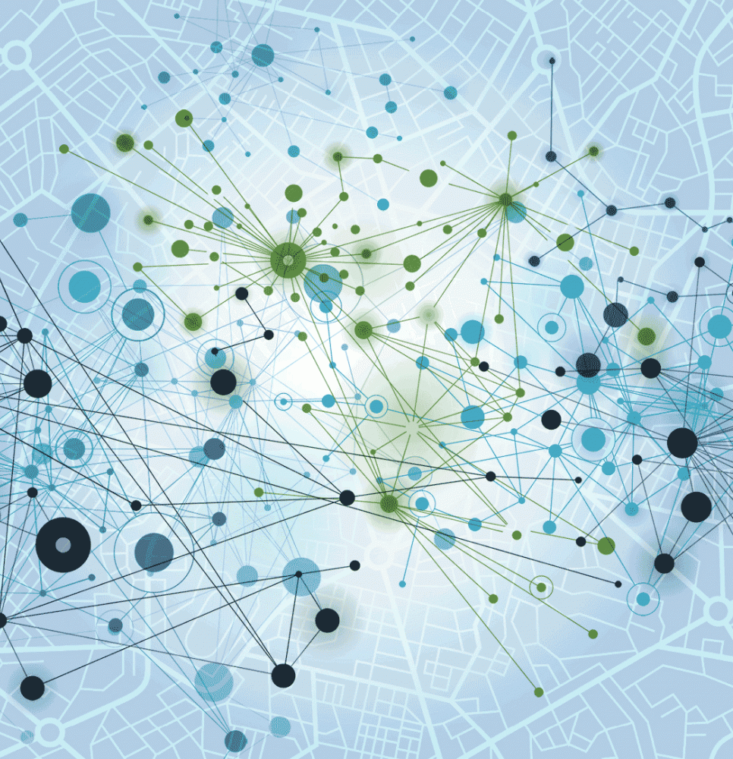
Data, Data, Data!
Location
Consumer
Mobility
New Forms of Data and the Analysis of Cities
Notes:
I’m going to talk to you about developments in three types of data that I have a lot of experience working with:
Location data
Consumer data
Mobility data

Slide 18
Data, Data, Data!
Location
New Forms of Data and the Analysis of Cities

Slide 19
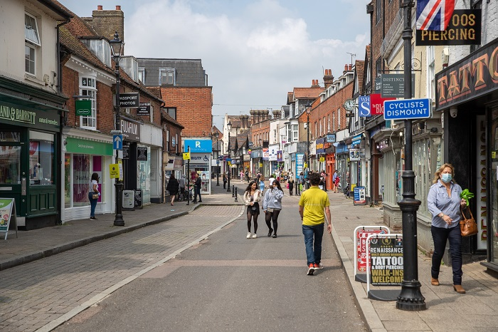
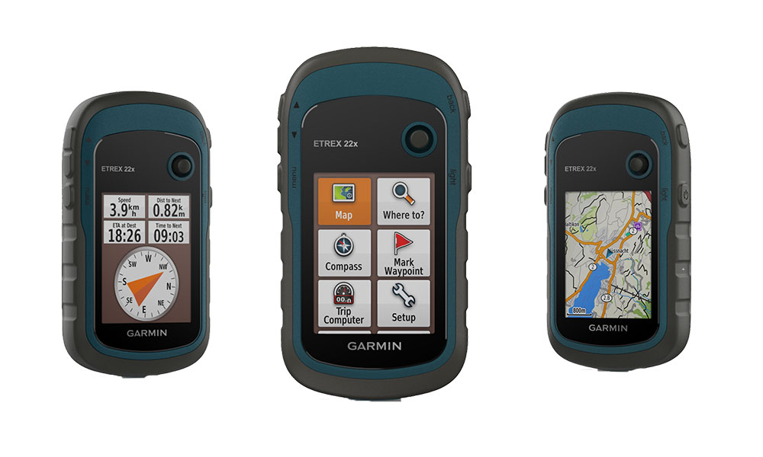

Location Data
New Forms of Data and the Analysis of Cities
Notes:
Manually collecting location data!
Surveys by Local Data Company to verify location of retailers; challenging at UK scale

Slide 20
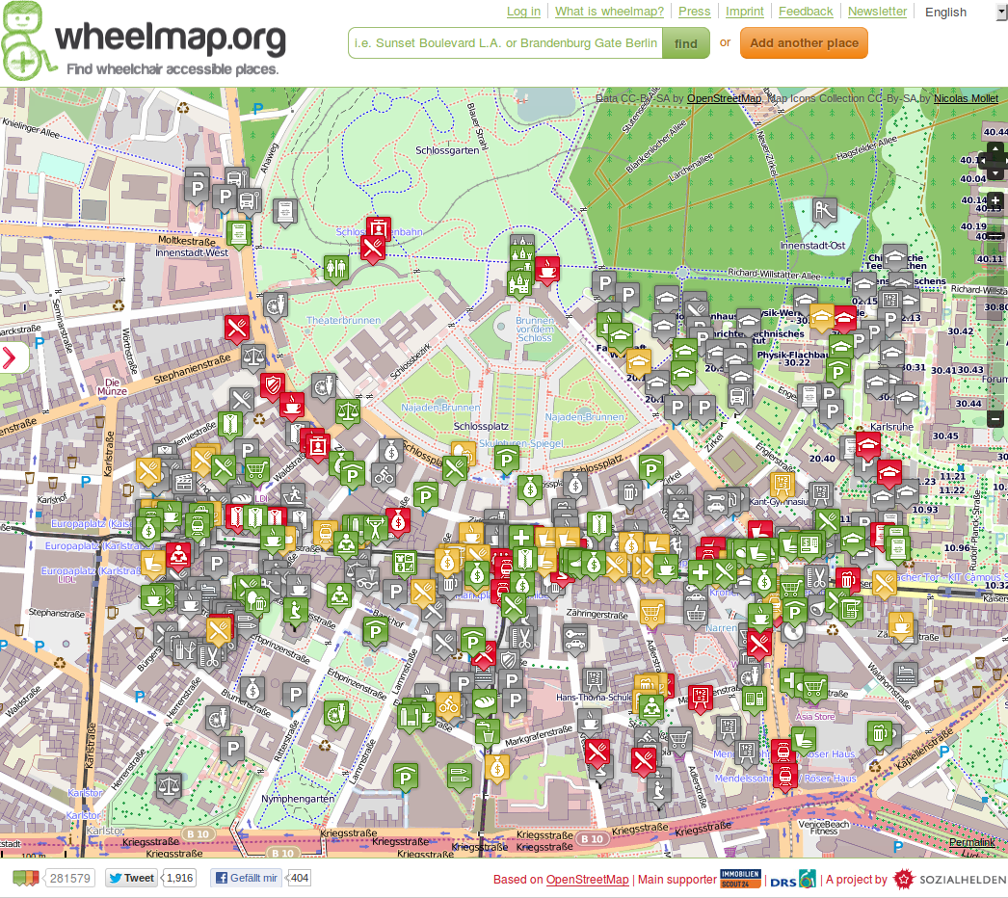
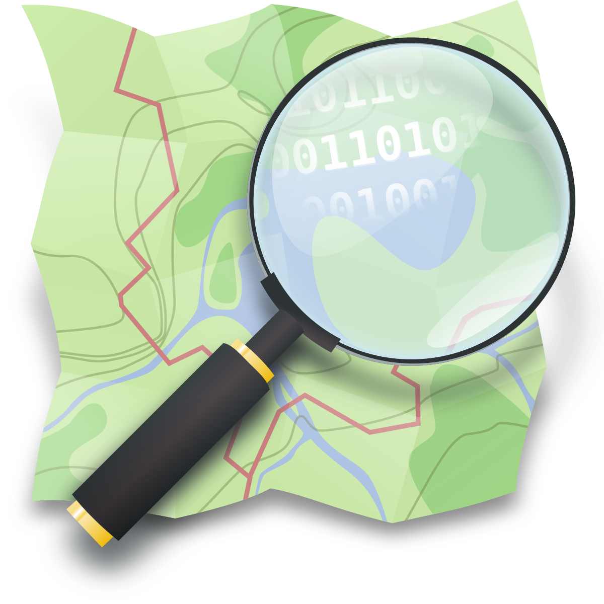
Location Data – OpenStreetMap
New Forms of Data and the Analysis of Cities
Notes:
OpenStreetMap; a collaborative project for collecting geographic data
Not entirely complete, subject to all kinds of issues with who is submitting data and for what locations, accuracy of submissions.

Slide 21
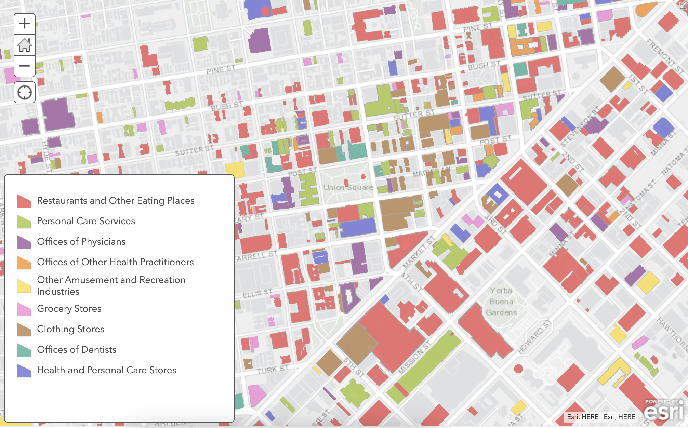

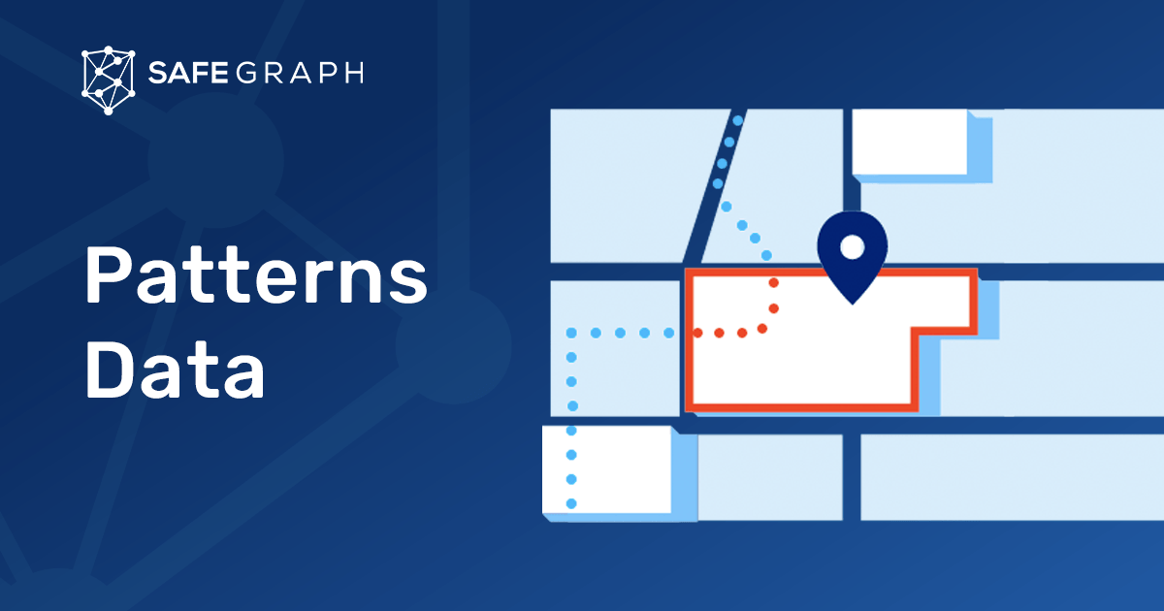
Location Data – SafeGraph
New Forms of Data and the Analysis of Cities
Notes:
Big companies like SafeGraph use more sophisticated methods;
Crawling websites of retailers, major brands
Using Open APIs to access locations of places, POIs
Machine learning to infer characteristics of places

Slide 22

Location Data – SafeGraph (2)
New Forms of Data and the Analysis of Cities
Notes:
Such location datasets are EXPENSIVE!
Fortunately, companies like SafeGraph are opening their data up for public good!

Slide 23
Data, Data, Data!
Consumer
New Forms of Data and the Analysis of Cities
Notes:
I’m going to talk to you about developments in three types of data that I have a lot of experience working with:
Location data
Consumer data
Mobility data

Slide 24
Data, Data, Data!
Mobility
New Forms of Data and the Analysis of Cities
Notes:
I’m going to talk to you about developments in three types of data that I have a lot of experience working with:
Location data
Consumer data
Mobility data

Slide 25
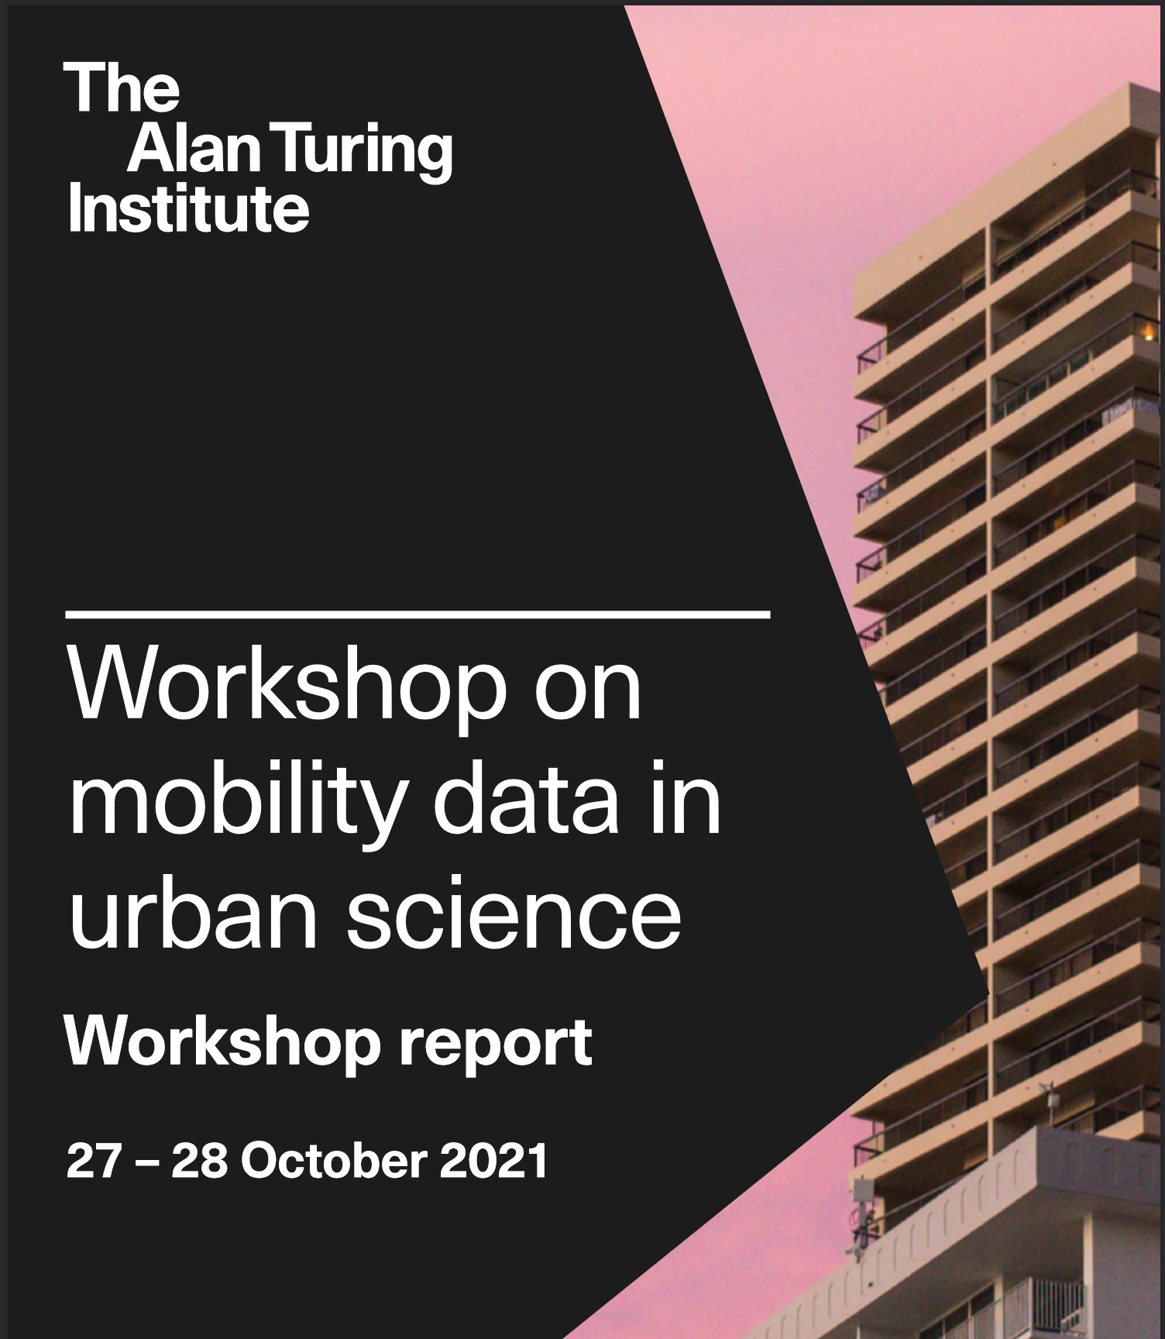
Mobility Data
Data have become a central pillar of society. Technological advances in computational power, storage and network platforms have enabled the production, processing, analysis and storage of large volumes of digital data. Information that previously could not be stored, or captured can now be digitally recorded.
A key data stream has been location data from mobile phones. More generally, mobile phone data are a rich source of information offering a unique opportunity to capture human behaviour at an unprecedented geographic and temporal resolution. Yet, key challenges remain, such as issues about privacy, representativeness, biases and the use of large, noisy and complex data sets
New Forms of Data and the Analysis of Cities
Notes:
I’m going to talk to you about developments in three types of data that I have a lot of experience working with:
Location data
Consumer data
Mobility data

Slide 26
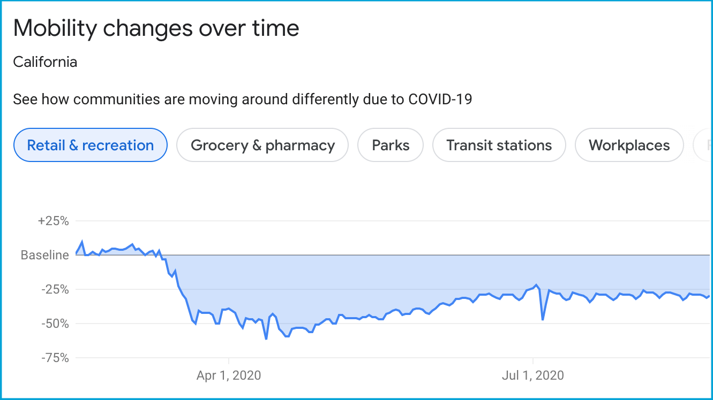

Mobility Data
New Forms of Data and the Analysis of Cities
Notes:
I’m going to talk to you about developments in three types of data that I have a lot of experience working with:
Location data
Consumer data
Mobility data

Slide 27
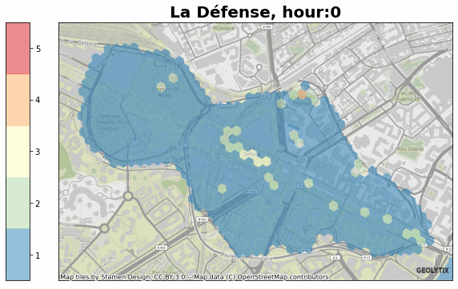

Mobility Data
New Forms of Data and the Analysis of Cities
Notes:
I’m going to talk to you about developments in three types of data that I have a lot of experience working with:
Location data
Consumer data
Mobility data

Slide 28
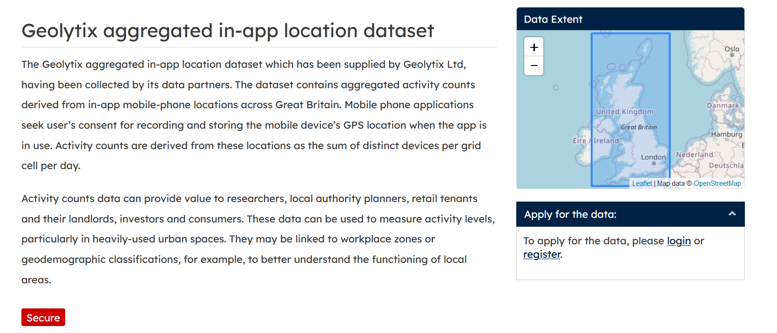
Mobility Data
data.cdrc.ac.uk/Geolytix-aggregated-app-location-dataset
New Forms of Data and the Analysis of Cities
Notes:
I’m going to talk to you about developments in three types of data that I have a lot of experience working with:
Location data
Consumer data
Mobility data

Slide 29
Mobility Data
data.cdrc.ac.uk/Geolytix-aggregated-app-location-dataset
New Forms of Data and the Analysis of Cities
Notes:
I’m going to talk to you about developments in three types of data that I have a lot of experience working with:
Location data
Consumer data
Mobility data

Slide 30
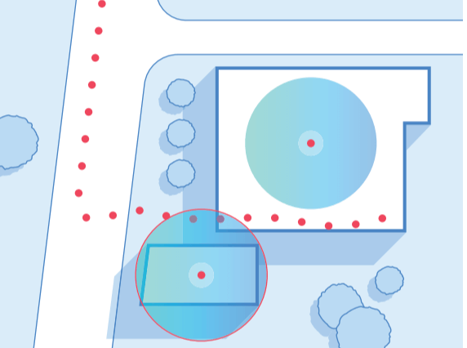
Mobility Data
New Forms of Data and the Analysis of Cities
Notes:
I’m going to talk to you about developments in three types of data that I have a lot of experience working with:
Location data
Consumer data
Mobility data

Slide 31
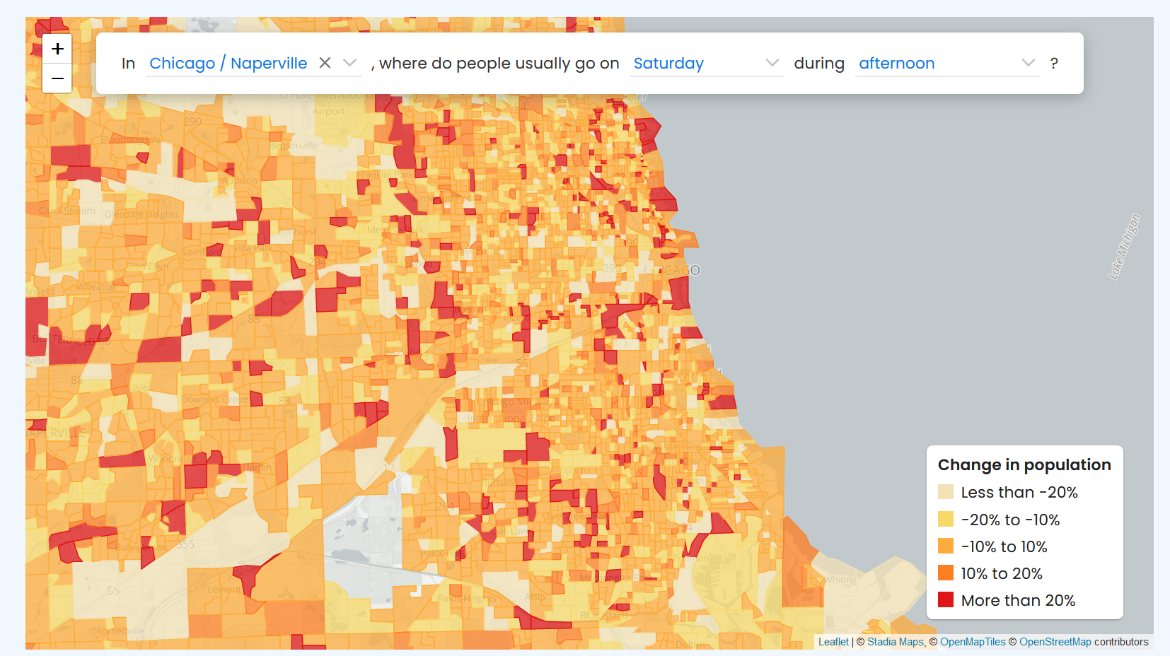
Mobility Data
New Forms of Data and the Analysis of Cities
Notes:
I’m going to talk to you about developments in three types of data that I have a lot of experience working with:
Location data
Consumer data
Mobility data

Slide 32
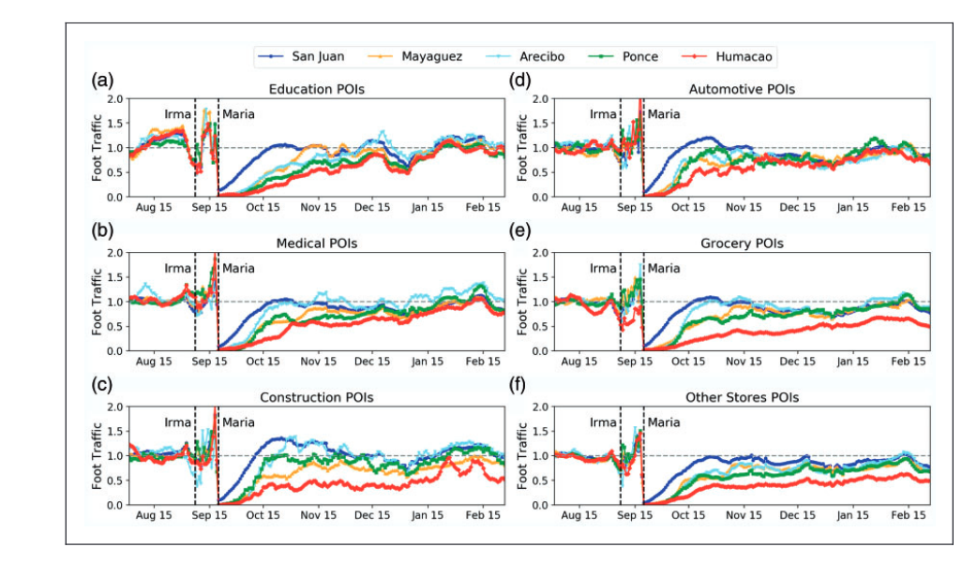
Mobility Data
New Forms of Data and the Analysis of Cities
Notes:
I’m going to talk to you about developments in three types of data that I have a lot of experience working with:
Location data
Consumer data
Mobility data

Slide 33
Mobility Data
New Forms of Data and the Analysis of Cities
Notes:
I’m going to talk to you about developments in three types of data that I have a lot of experience working with:
Location data
Consumer data
Mobility data

Slide 34
Overview
Cities; form and function
New forms of data = insights
Case study; retail centres
New Forms of Data and the Analysis of Cities

Slide 35
New Forms of Data and the Analysis of Cities
Patrick Ballantyne, University of Liverpool
P.Ballantyne@liverpool.ac.uk

